Slide 1
2. Sources of Bias

Slide 2
What is a bias ?
Inclination or prejudice of a decision made by an AI system which is for or against one person or group, especially in a way considered to be unfair.
From Bias in Data-driven AI Systems - An Introductory Survey
(Ntoutsi et al., 2020)

Slide 3
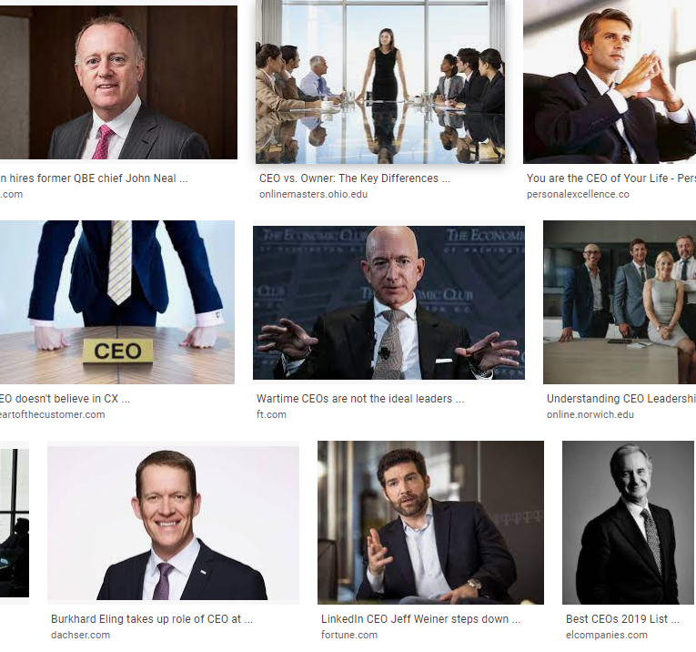
Historical bias
Pre-existing bias reflected in the data
Example: What should be the results of an image search for ‘CEO’? In 2018, 5% of Fortune 500 CEOs were women.
Google recently changed image search result to include higher proportion of women
Notes:
Suresh, H., & Guttag, J. V. (2019). A framework for understanding unintended consequences of machine learning. arXiv preprint arXiv:1901.10002.

Slide 4

Representation bias
Occurs when certain parts of the input space are underrepresented
sampling methods only reach a portion of the population
population of interest ≠ training data
Example: ImageNet. 45% from US. 1% from China.
Classifier for ‘bride’ performs worse in under-represented countries
Notes:
population of interest ≠ training data. Over time or geographically

Slide 5
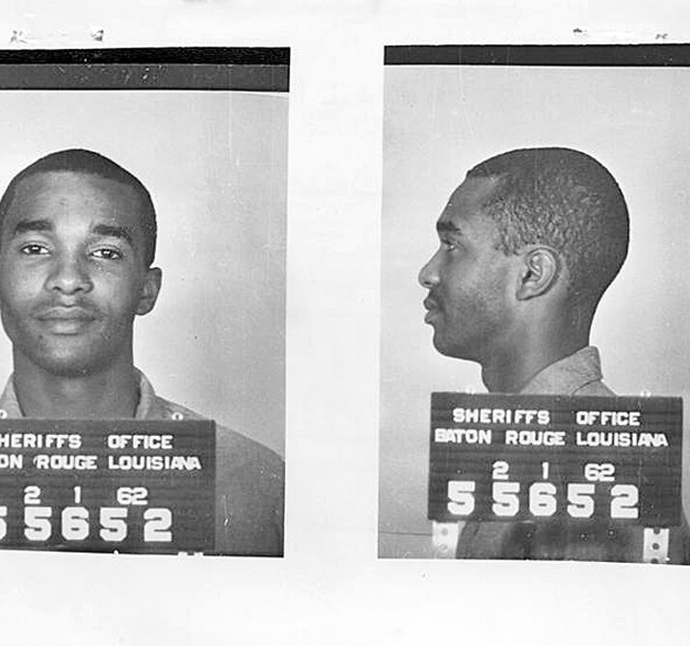
Measurement Bias
Occurs when selecting or collecting features.
Measurement process/ data quality may vary across groups
Example:
Arrest rates used as a measure for crime rate.
COMPAS: prior arrests + friend/family arrests to measure recidivism

Slide 6
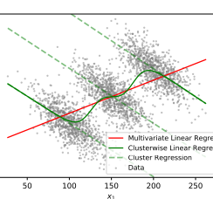
Aggregation Bias
One-size fit all model
Difference across groups might require several models
Example: HbA1c levels (used to monitor diabetes) differ across gender and ethnicity
Mehrabi, N., Morstatter, F., Saxena, N., Lerman, K., & Galstyan, A. (2019). A survey on bias and fairness in machine learning. arXiv preprint arXiv:1908.09635.
Notes:
A Survey on Bias and Fairness in Machine Learning

Slide 7

Evaluation bias
When testing on benchmarks that are unbalanced compared to target population
Example: Adience and IJB-A in Gender Shades
The Algorithmic Justice League by Joy Buolamwini

Slide 8

Deployment Bias
Mismatch between design and use
Example: person’s likelihood of committing a future crime → high-stake use of determining the length of a sentence

Slide 9
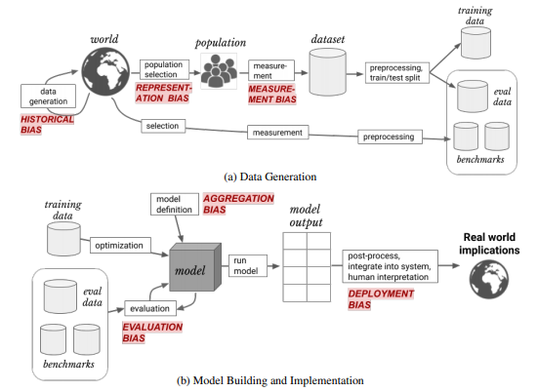
An overview
Taken from :
Suresh, H., & Guttag, J. V. (2019). A framework for understanding unintended consequences of machine learning. arXiv preprint arXiv:1901.10002.
Notes:
CITE REFS
Suresh, Harini, and John V. Guttag. "A framework for understanding unintended consequences of machine learning." arXiv preprint arXiv:1901.10002 (2019).

Slide 10
Reading/References
(Mehrabi et al., 2021). A survey on bias and fairness in machine learning
(Suresh & Guttag, 2019). A Framework for Understanding Sources of Harm throughout the Machine Learning Life Cycle

